Slide 1

OPTIMIZING TRANSPORTATION
EFFICIENCY : BUSINESS INSIGHT FROM UBER DATA ANALYTICS

Slide 2













S. T. A. R FRAMEWORK
Uber is a cab service company operating in 10 tier-2 cities across india
The company aim to improve operational efficiency and passenger satisfaction in 2024
SQL based reports for business critical ad-hoc request
Build interactive dashboard that provide a self explanatory view of key metrics
A structured presentation of findings with actionable recommendations
Situation
Task
Results
Action
Boost repeated customer retention through loyalty program
Optimized trip distribution strategy for higher profitability and demand balancing
Identifying peak book times, improving driver availability
Data understanding and Preparation
Analysis and Insight Generations
Presentation and Story-telling

Slide 3


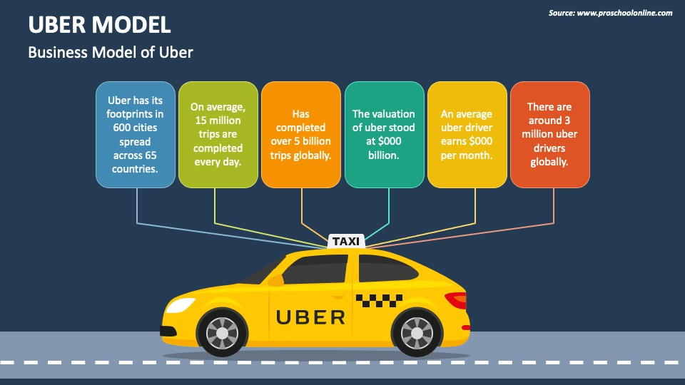

Slide 4
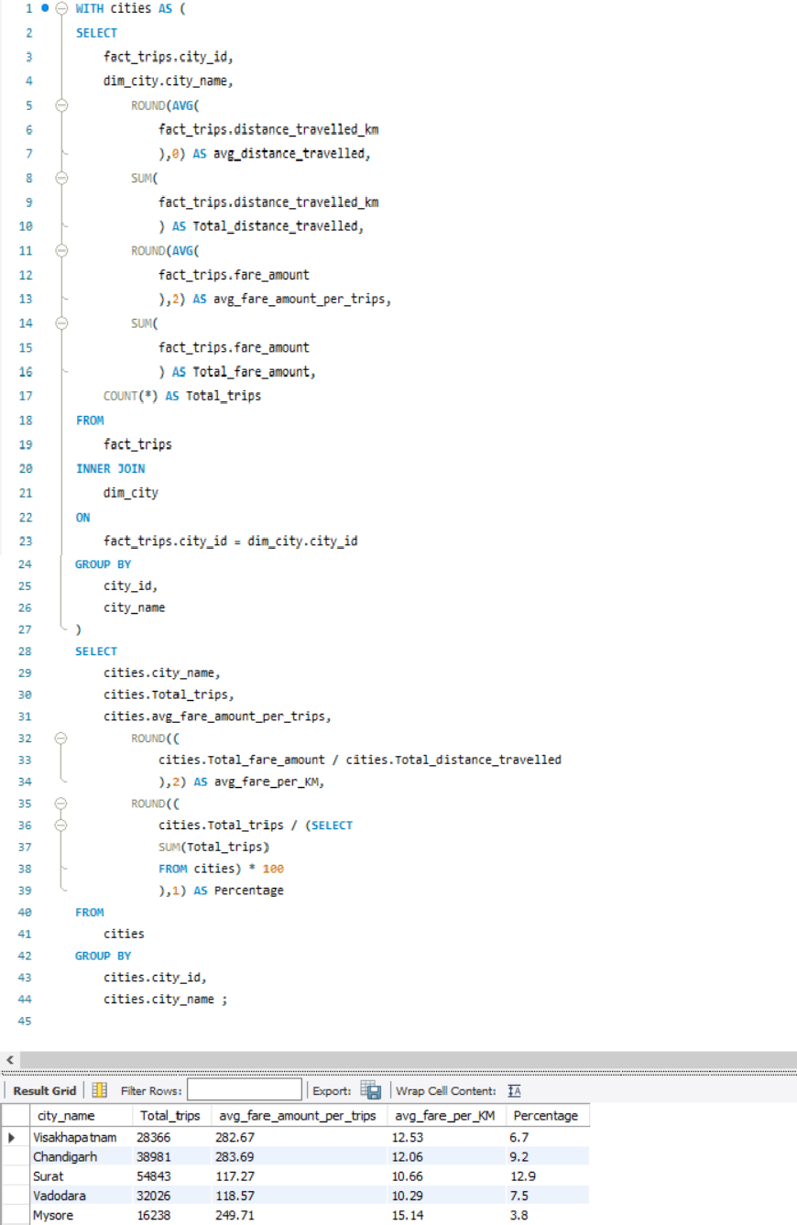
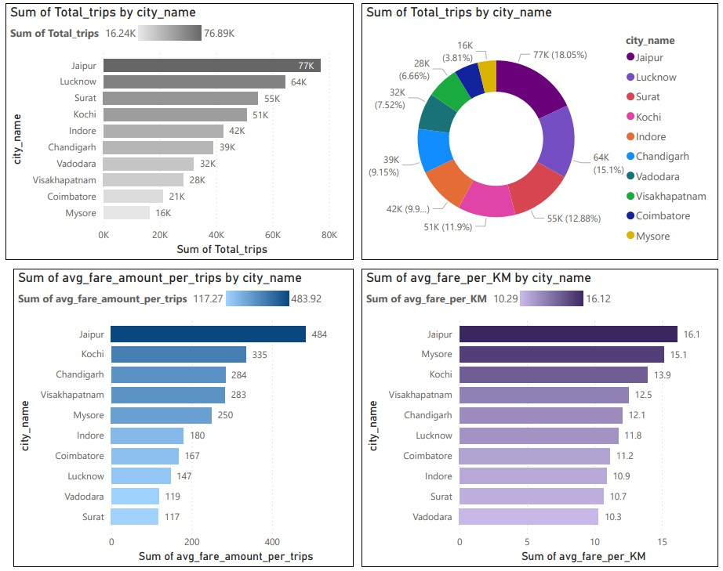
B U S I N E S S R E Q U E T S 1
City-Level Fare and Trip Summary: -
Generate a report that display the total trips, average fare per KM, average fare per trips, and the percentage contribution of each city’s trips to the overall trips. This report will help in assessing trip volume, pricing efficiency, and each city’s contribution to the overall trip count.

Slide 5
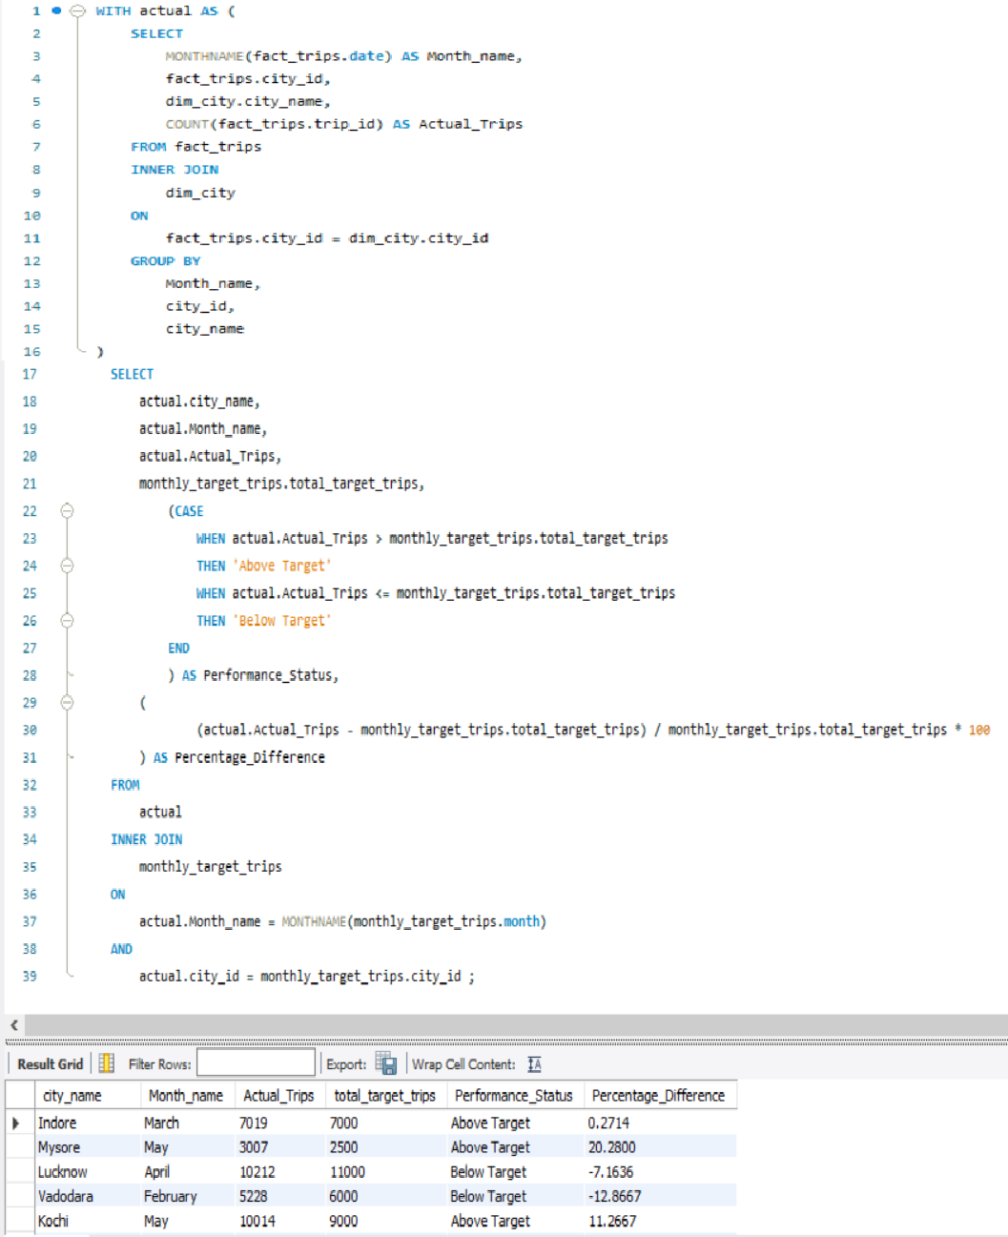
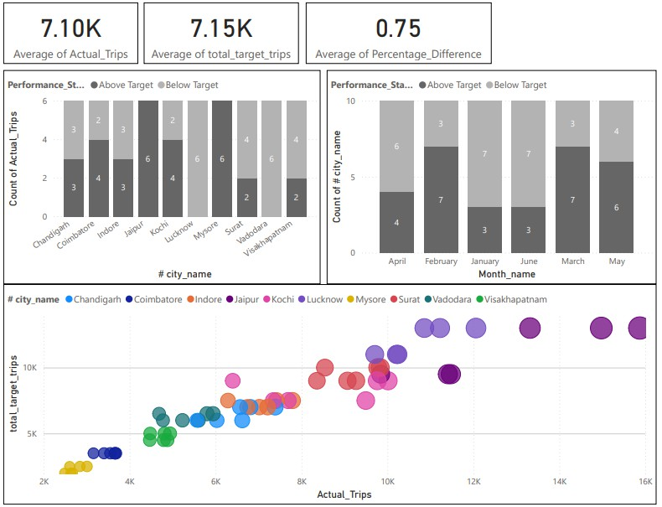
B U S I N E S S R E Q U E T S 2
Monthly City-Level Trips Target Performance Report :-
Generate a report that evaluates the target performance of trips at the monthly and city level. For each city and month, compare the actual trips with the target trips and categorized the performance.
If actual trips are greater than target trips “Above Target”
If actual trips are less than equal to target trips “Below Target”
Additionally, calculated the % difference between actual and target trips to quantify the
performance gap.

Slide 6
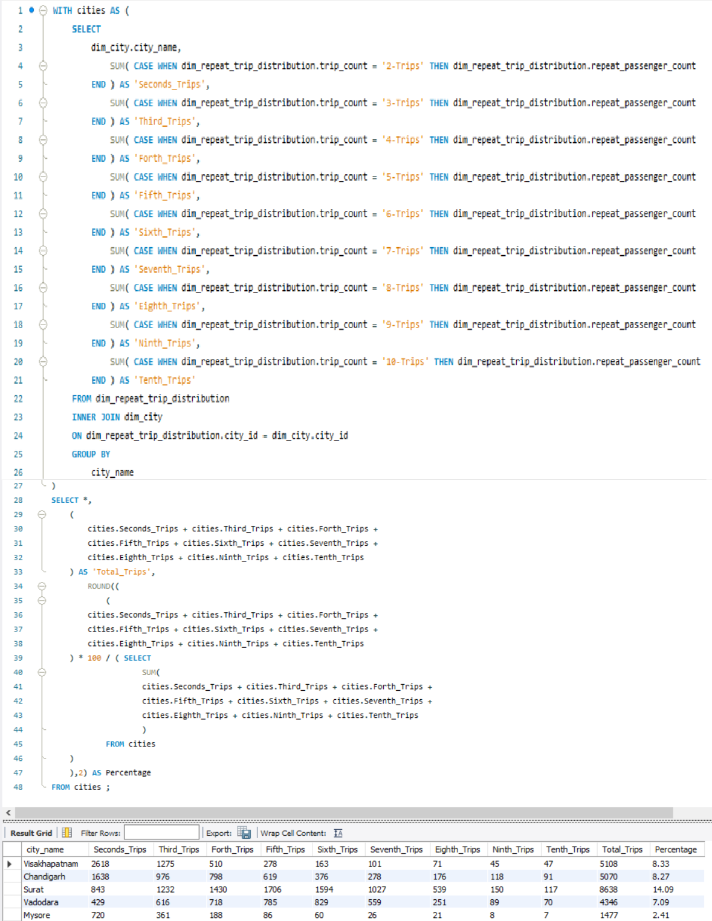
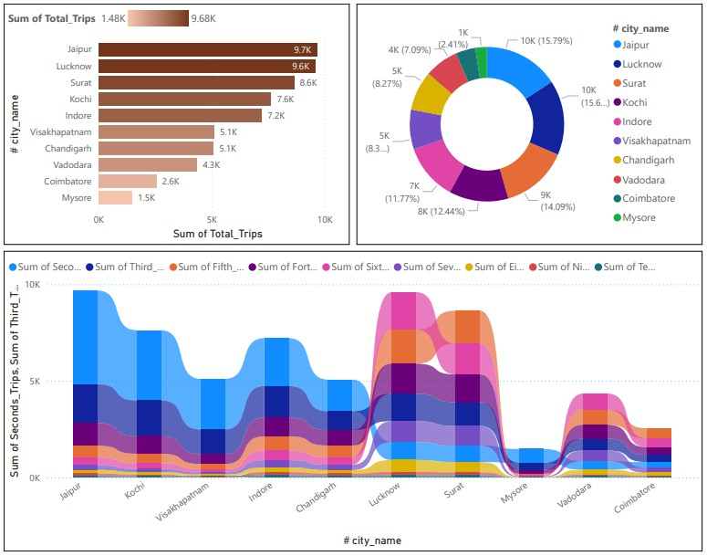
B U S I N E S S R E Q U E T S 3
City-Level Request Passenger Trips Frequency Report:-
Generate a report that show that percentage distribution of repeat passenger by the number of trips they have taken each city. Calculating the percentage of repeat passenger who took 2 Trips, 3 Trips and so on up to 10 Trips.
Each columns should represent a trips count category, displaying the percentage of repeat passenger who fall into that category put of total repeat passenger for that city.
This report will help identify cities with repeat trips frequency, which can indicates
strong customer loyalty or frequently usage patterns.

Slide 7
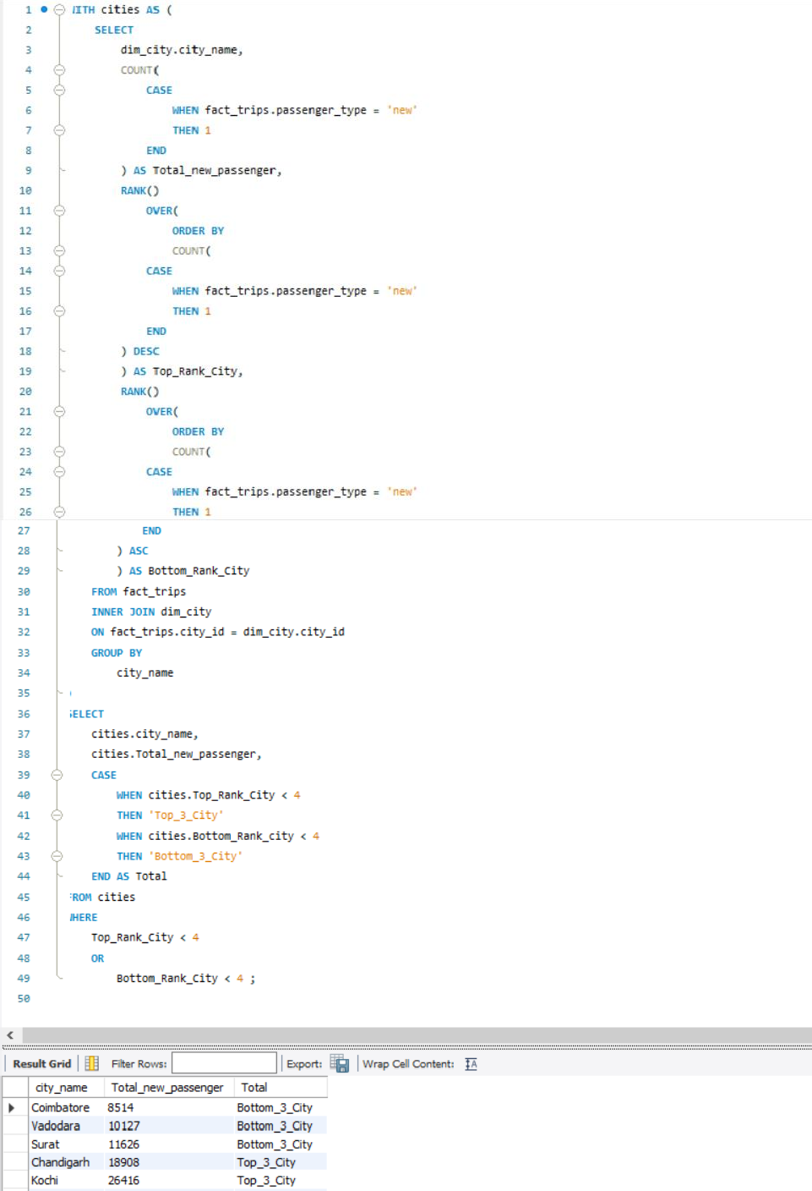
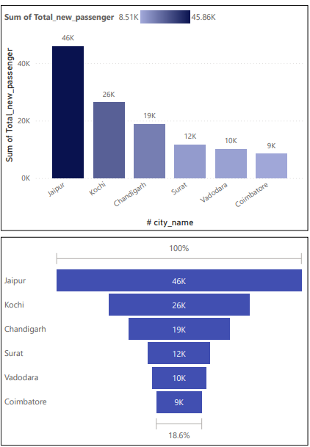
B U S I N E S S R E Q U E T S 4
Identify Cities With Highest and Lowest Total new Passenger :-
Generate a report that calculates the total new passenger for each city and ranks them based on this value. Identify the Top 3 cities with the highest number of new passenger as well as the bottom 3 cities with the lowest number of new passenger, categorized them as the “Top 3” or “Bottom 3” accordingly.

Slide 8
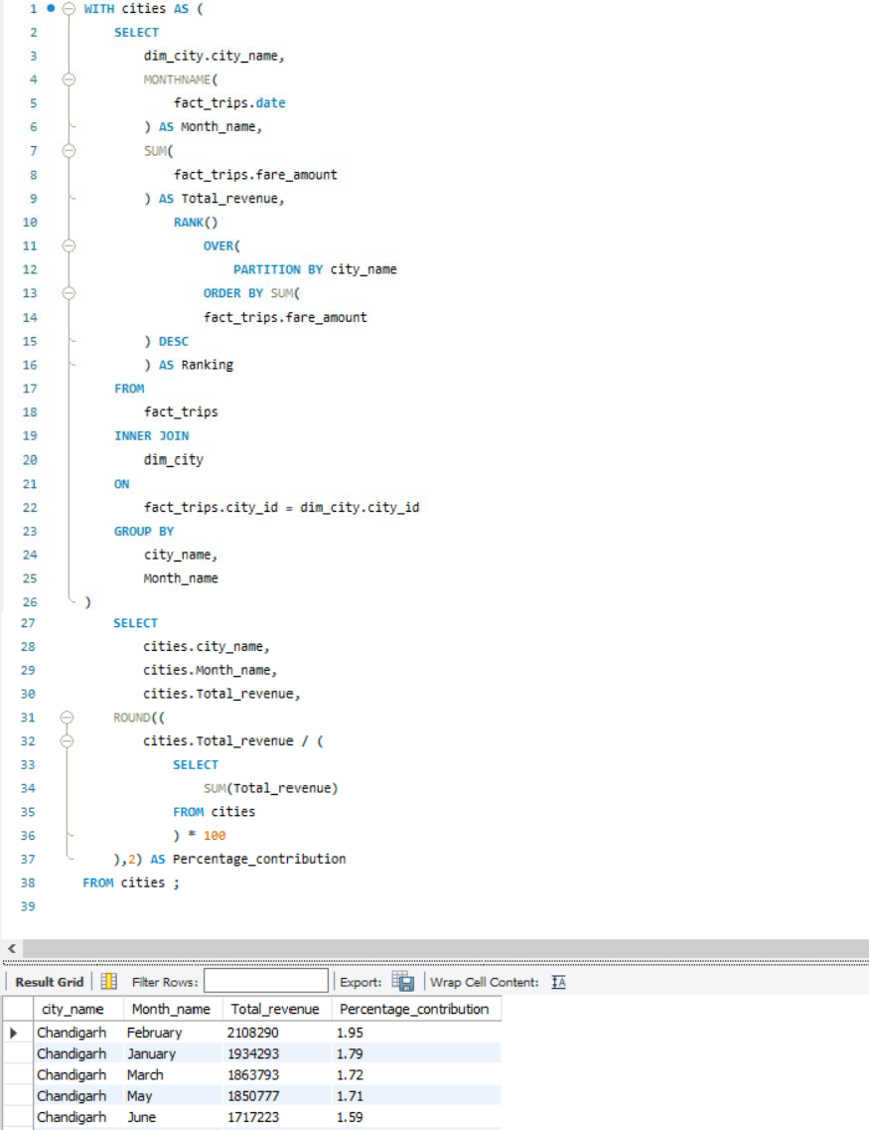
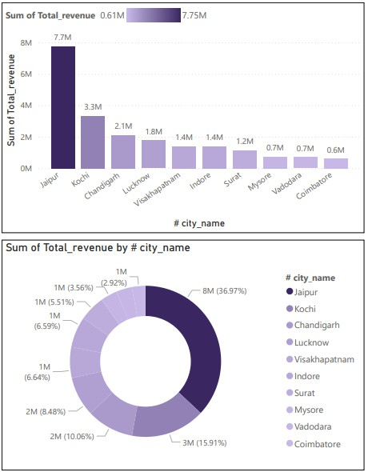
B U S I N E S S R E Q U E T S 5
Identify Month with Highest Revenue For Each City :-
Generate a report that identifies the month with the highest revenue for each city. For each city display the month name, the revenue amount for that month, and the percentage contribution of that month’s revenue to the city’s total revenue.

Slide 9
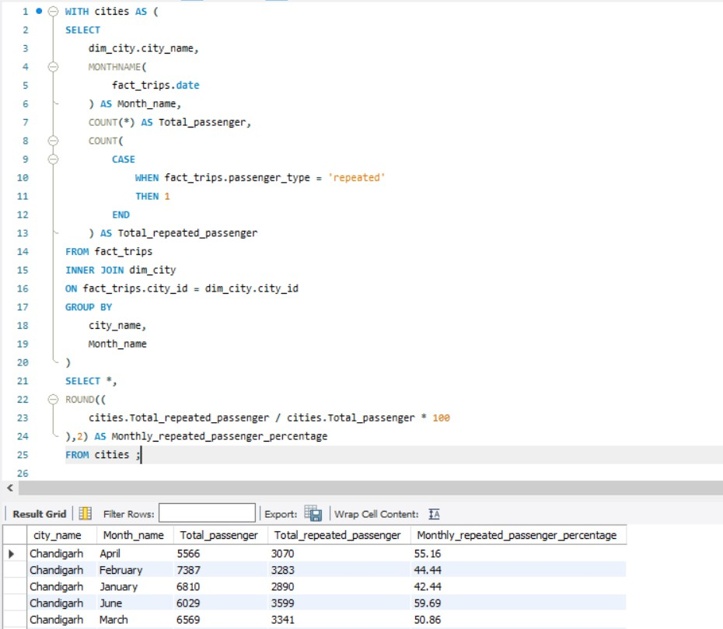
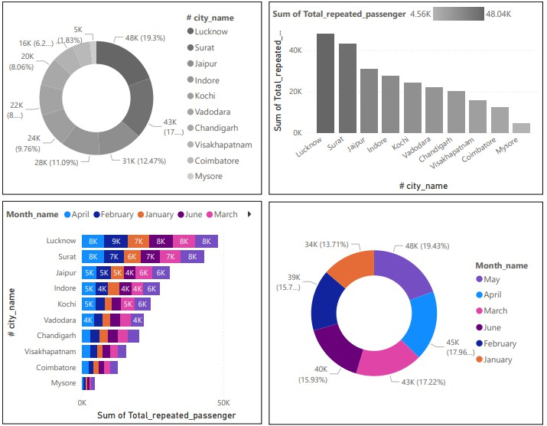
B U S I N E S S R E Q U E T S 6
Repeat Passenger Rate Analysis :-
Generate a report that calculates two metrics
Monthly repeat passenger rate :- Calculate the repeat passenger rate for each city and month by comparing the number of repeat passenger to the total passenger.
City-wide repeat passenger rate :- Calculate the overall repeat passenger rate for each city, considering all passenger across month.

Slide 10



KEY TAKEAWAYS
Jaipur is the Top perform in tips, revenue and new
passenger acquisition
Lucknow and Surat have high repeat passenger rates, indicating good customer retention
April and May are peak months, while January and June need improvement
There is a close match between actual and target trips, which is a positive operational efficiency indicators

Slide 11













Pitch Deck

